Slide 1


Analysis of algorithmic efficiency: Asymptotic notations and their properties Session No.: 3 Course Name: Design and analysis of algorithms Course Code: R1UC302B Instructor Name: Rakesh Bharati Duration: 40 min Date of Conduction of Class:

Slide 2

RECAP: An algorithm is a sequence of unambiguous instructions for solving a problem, i.e., for obtaining a required output for any legitimate input in a finite amount of time.

Slide 3
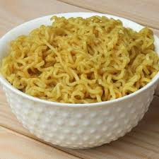


A Small Activity
G1: Write an algorithm to prepare Maggie. G2:Write an algorithm to prepare Tea. G3: Write an algorithm to prepare a chapati.

Slide 4
Ask Questions
Can you compare the time taken by the 3 algorithms that you have written?
How are you able to compare the time.
Discuss among your table members.

Slide 5
At the end of this session students will be able to
Learning Outcome 1:Understand the importance of analyzing algorithm efficiency.
Learning Outcome 2 : Comprehend different asymptotic notations.

Slide 6
Session Outline
1 Introduction
2
3
4
5
6
Learning activity 1
Concept and Definition for Learning Activity 2
Learning Activity 2
Properties of Asymptotic Notations
Problem Solving and Hands-On Practice

Slide 7
Introduction to algorithmic analysis
Time efficiency (time complexity): indicates how fast an algorithm runs
• Space efficiency (space complexity): refers to the amount of memory units required by the algorithm in addition to the space needed for its input and output
•The time efficiency of an algorithm is typically as a function of the input size (one or more input parameters).

Slide 8
Time Complexity
Time complexity of an algorithm can be calculated by
Time complexity of an algorithm can be calculated by using two methods: Posteriori Analysis(Done after implementation of Algorithm) Priori Analysis(Done on Algorithm)

Slide 9
Concept and Definition for Learning Activity 1 Asymptotic Notations
-It is shorthand way of representing running time of an algorithm
- The main idea is to measure of efficiency of algorithms that doesn’t depend on machines.
There are mainly three asymptotic notations: Big-O Notation (O-notation) Omega Notation (Ω-notation) Theta Notation (Θ-notation)

Slide 10
Big-O Notation (O-notation):
Big-O notation represents the upper bound of the running time of an algorithm. Therefore, it gives the worst-case complexity of an algorithm.
It is the most widely used notation for Asymptotic analysis. It specifies the upper bound of a function. The maximum time required by an algorithm or the worst-case time complexity. It returns the highest possible output value(big-O) for a given input. Big-O(Worst Case) It is defined as the condition that allows an algorithm to complete statement execution in the longest amount of time possible.

Slide 11
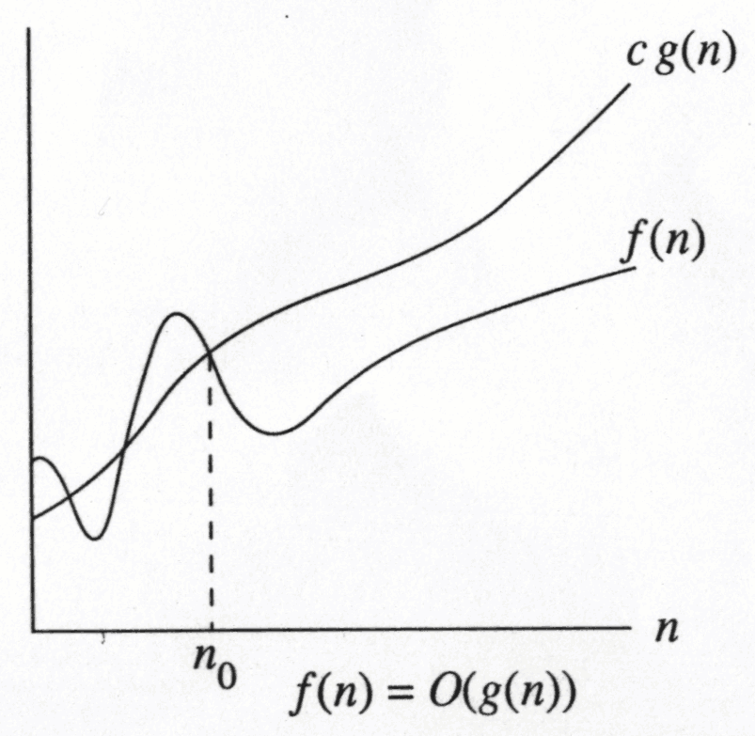
Growth Rate
The idea is to establish a relative order among functions for large n
∃ c , n₀ > 0 such that f(N) ≤ c g(N) when N ≥ n₀
f(N) grows no faster than g(N) for “large” N

Slide 12
Asymptotic notation: Big-Oh
f(N) = O(g(N))
There are positive constants c and n₀ such that
f(N) ≤ c g(N) when N ≥ n₀
The growth rate of f(N) is less than or equal to the growth rate of g(N)
g(N) is an upper bound on f(N)

Slide 13
Big-Oh: example
Let f(N) = 2N². Then
f(N) = O(N⁴)
f(N) = O(N³)
f(N) = O(N²) (best answer, asymptotically tight)
O(N²): reads “order N-squared” or “Big-Oh N-squared”

Slide 14
Big Oh: more examples
N² / 2 – 3N = O(N²)
1 + 4N = O(N)
7N² + 10N + 3 = O(N²) = O(N³)
log₁₀ N = log₂ N / log₂ 10 = O(log₂ N) = O(log N)
sin N = O(1); 10 = O(1), 10¹⁰ = O(1)
log N + N = O(N)
log^{k} N = O(N) for any constant k
N = O(2^{N}), but 2^{N} is not O(N)
2^{10N} is not O(2^{N})

Slide 15
Omega Notation (Ω-Notation):
Omega notation represents the lower bound of the running time of an algorithm. Thus, it provides the best case complexity of an algorithm. The execution time serves as a lower bound on the algorithm’s time complexity. It is defined as the condition that allows an algorithm to complete statement execution in the shortest amount of time.

Slide 16
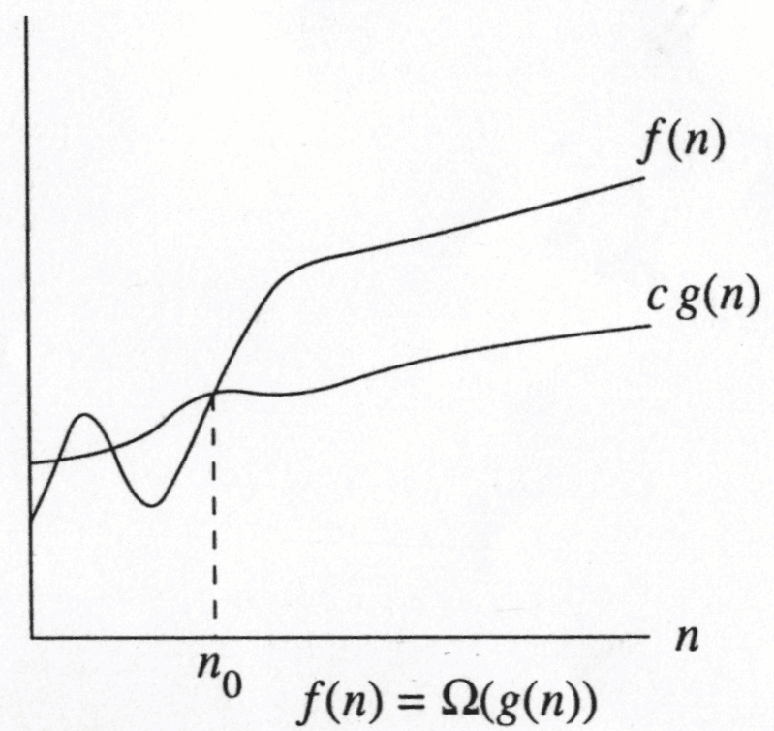
Big-Omega
∃ c , n₀ > 0 such that f(N) ≥ c g(N) when N ≥ n₀
f(N) grows no slower than g(N) for “large” N

Slide 17
Big-Omega
f(N) = Ω(g(N))
There are positive constants c and n₀ such that
f(N) ≥ c g(N) when N ≥ n₀
The growth rate of f(N) is greater than or equal to the growth rate of g(N).

Slide 18
Big-Omega: examples
Let f(N) = 2N². Then
f(N) = Ω(N)
f(N) = Ω(N²) (best answer)

Slide 19
Theta Notation (Θ-Notation):
Theta notation encloses the function from above and below. Since it represents the upper and the lower bound of the running time of an algorithm, it is used for analyzing the average-case complexity of an algorithm. Theta (Average Case) You add the running times for each possible input combination and take the average in the average case.

Slide 20
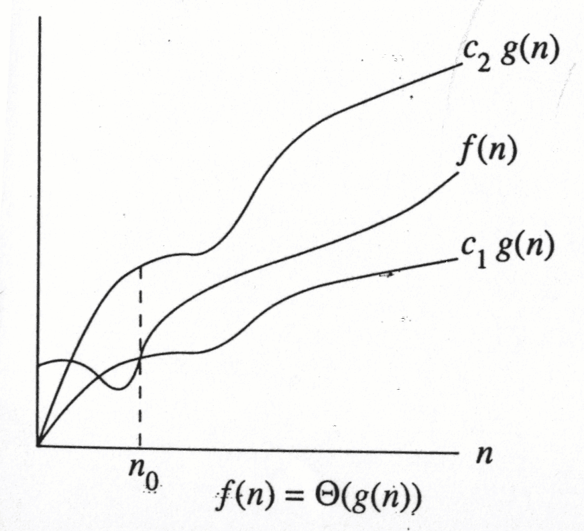
f(N) = Θ(g(N))
the growth rate of f(N) is the same as the growth rate of g(N)

Slide 21
Big-Theta
f(N) = Θ(g(N)) iff
f(N) = O(g(N)) and f(N) = Ω(g(N))
The growth rate of f(N) equals the growth rate of g(N)
Example: Let f(N)=N² , g(N)=2N²
Since f(N) = O(g(N)) and f(N) = Ω(g(N)),
thus f(N) = Θ(g(N)).
Big-Theta means the bound is the tightest possible.

Slide 22
Some rules
If T(N) is a polynomial of degree k, then
T(N) = Θ(N^{k}).
For logarithmic functions,
T(log_{m} N) = Θ(log N).

Slide 23
Growth rates …
Doubling the input size
f(N) = c ⇒ f(2N) = f(N) = c
f(N) = log N ⇒ f(2N) = f(N) + log 2
f(N) = N ⇒ f(2N) = 2 f(N)
f(N) = N² ⇒ f(2N) = 4 f(N)
f(N) = N³ ⇒ f(2N) = 8 f(N)
f(N) = 2^{N} ⇒ f(2N) = f²(N)
Advantages of algorithm analysis
To eliminate bad algorithms early

Slide 24
o-notation:
For a given function g(n), the set little-o:
o(g(n)) = {f(n): ∀ c > 0, ∃ n₀ > 0 such that ∀ n ≥ n₀, we have 0 ≤ f(n) < cg(n)}.
f(n) becomes insignificant relative to g(n) as n approaches infinity:
lim [f(n) / g(n)] = 0
^{n→∞}
g(n) is an upper bound for f(n) that is not asymptotically tight.

Slide 25
ω -notation
For a given function g(n), the set little-omega:
ω(g(n)) = {f(n): ∀ c > 0, ∃ n₀ > 0 such that ∀ n ≥ n₀, we have 0 ≤ cg(n) < f(n)}.
f(n) becomes arbitrarily large relative to g(n) as n approaches infinity:
lim [f(n) / g(n)] = ∞.
^{n→∞}
g(n) is a lower bound for f(n) that is not asymptotically tight.

Slide 26
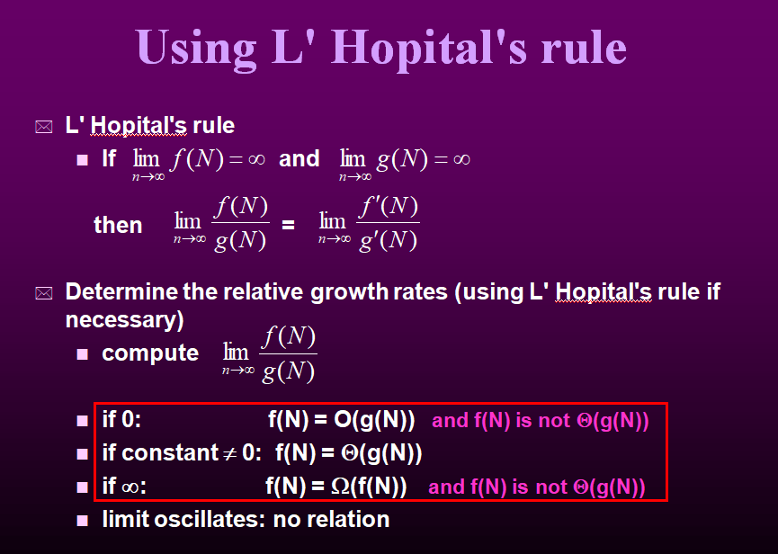

Slide 27
Learning Activity 2
Group1: Bubble sort
Group 2: Selection sort
Group 3: Quick Sort
Take 3-4 minutes of your time and analyse the best and worst time complexity of these sorting algorithms.

Slide 28
Reflection- Learning Activity 2
What will happen if the input size vary in all the algorithms?
Does the time complexity also depends on the input size?

Slide 29
Properties of Asymptotic Notations:
General Properties:
If f(n) is O(g(n)) then a*f(n) Is also O(g(n)), where a is a constant.
Transitive Properties: If f(n) is O(g(n)) and g(n) is O(h(n)) then f(n) = O(h(n))
Reflexive Properties: Reflexive properties are always easy to understand after transitive. If f(n) is given then f(n) is O(f(n)). Since MAXIMUM VALUE OF f(n) will be f(n) ITSELF!

Slide 30
Properties of Asymptotic Notations:
Symmetric Properties: If f(n) is Θ(g(n)) then g(n) is Θ(f(n))
Transpose Symmetric Properties: If f(n) is O(g(n)) then g(n) is Ω (f(n))

Slide 31
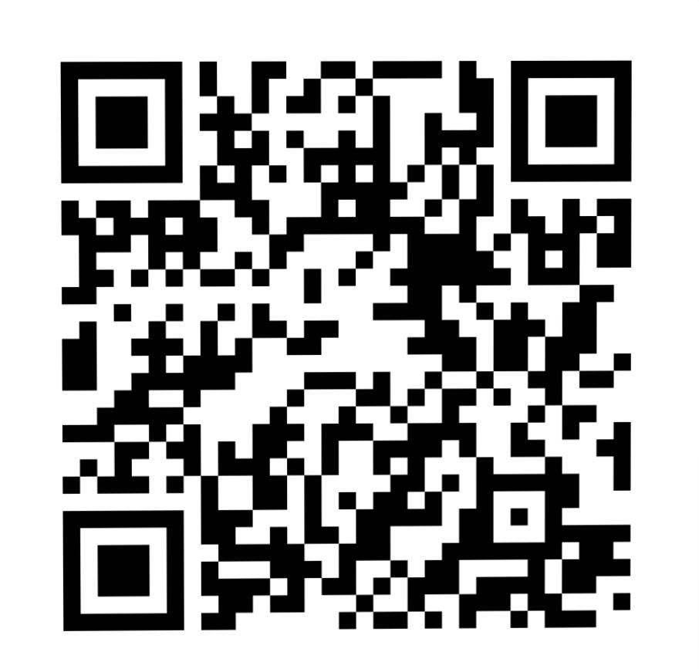
Problem Solving and Hands-On Practice
Take this 5 minutes quiz for better understanding
Participation Link –
https://app.wooclap.com/PAALXO?from=instruction-slide
You can also join using woo lap code - PAALXO

Slide 32
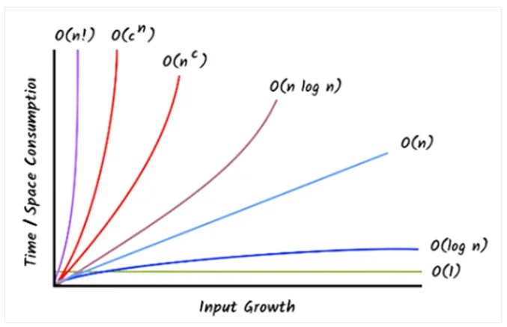
Summary

Slide 33
Discussion on the post session activities
Ask your doubts

Slide 34
Information about the next lesson
Analysis Framework and Empirical Analysis

Slide 35

Review and Reflection from students
Provide your feedback on analysis of algorithms effeciency session.

